Slide 1


Non-leptonic Weak Decays of Charmed Baryons
Particle 2019, Jan. 20-26, Guangzhou
Fanrong Xu
Jinan University
Jan. 24, 2019

Slide 2
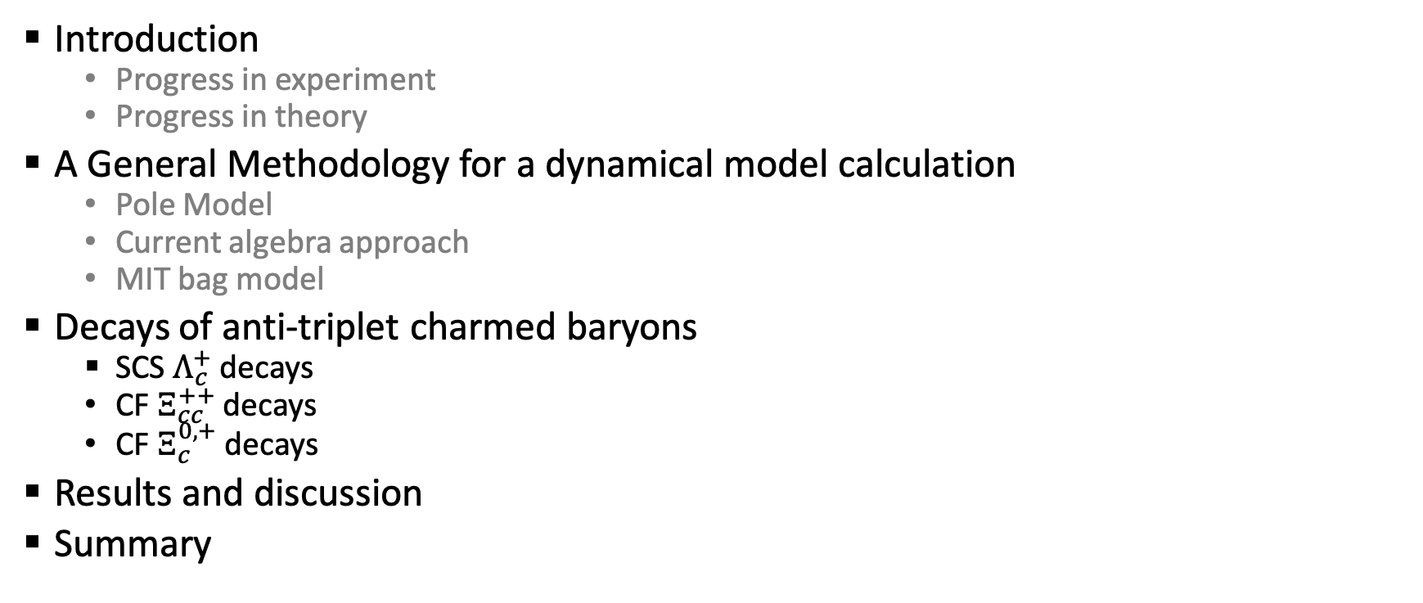
Outline
Introduction
Progress in experiment
Progress in theory
A General Methodology for a dynamical model calculation
Pole Model
Current algebra approach
MIT bag model
Decays of anti-triplet charmed baryons
SCS $Λ_{c}^{+}$ decays
CF $Ξ_{cc}^{++}$ decays
CF $Ξ_{c}^{0,+}$ decays
Results and discussion
Summary

Slide 3
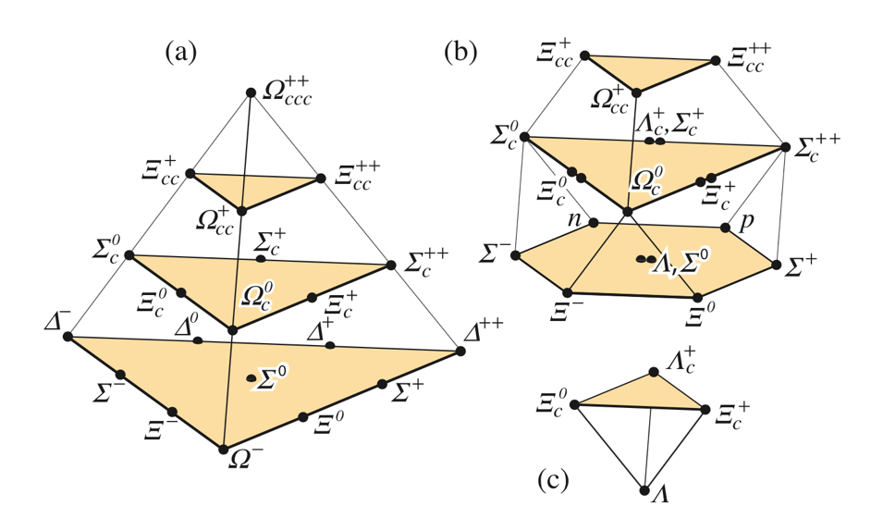
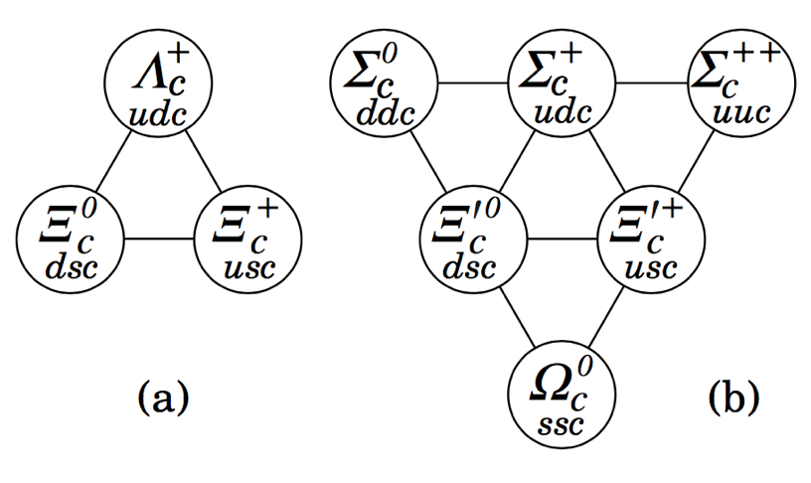
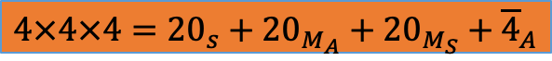

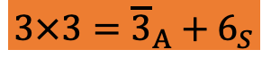
Introduction
Classification of Charmed Baryons
Singly charmed baryons
SU(4)
SU(3)
$$4×4×4={20}_{s}+{20}_{M_{A}}+{20}_{M_{S}}+{\overline{4}}_{A}$$
$$3×3={\overline{3}}_{A}+6_{S}$$
Observation
(Weak) Decays
Lifetimes
flavor:
$$3×3×3={10}_{s}+8_{M_{A}}+8_{M_{S}}+1_{A}$$

Slide 4
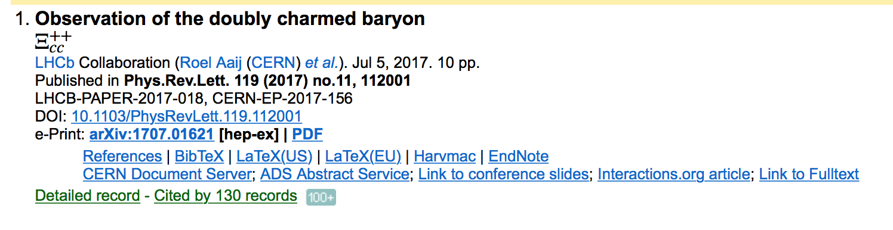
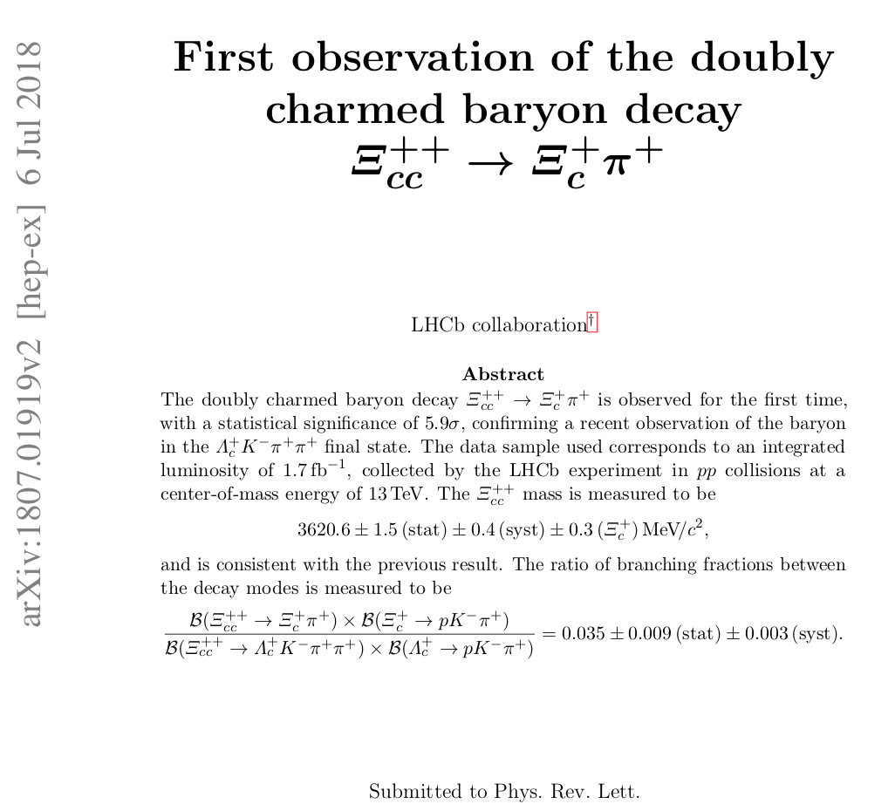
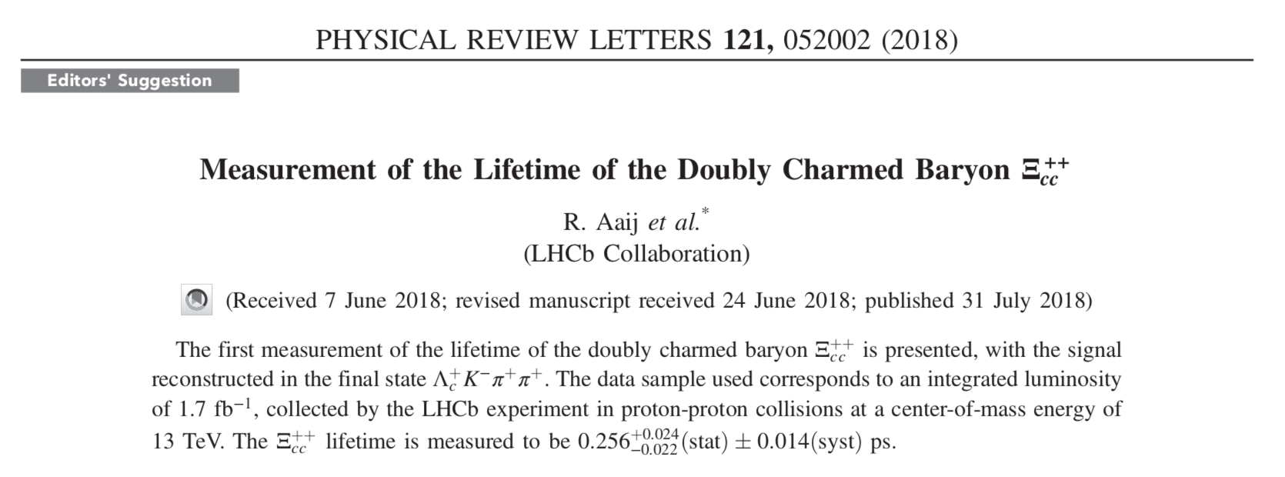
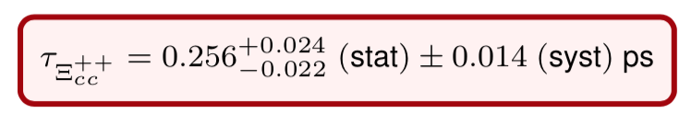
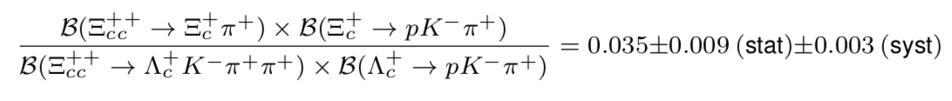
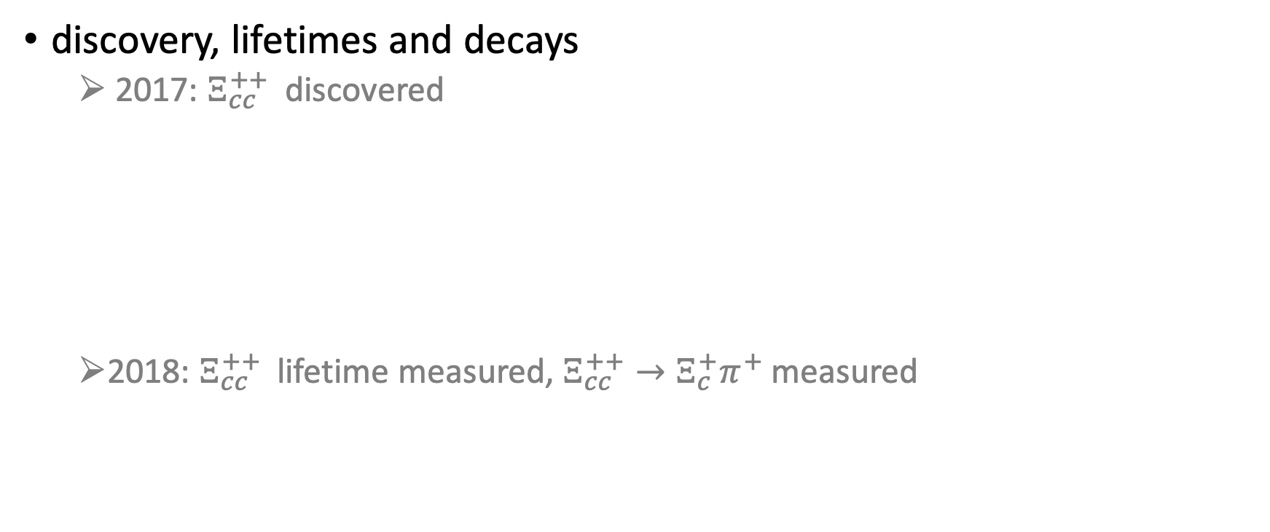
Progress in doubly charmed baryons
discovery, lifetimes and decays
2017: $Ξ_{cc}^{++}$ discovered
2018: $Ξ_{cc}^{++}$ lifetime measured, $Ξ_{cc}^{++}→Ξ_{c}^{+}π^{+}$measured

Slide 5
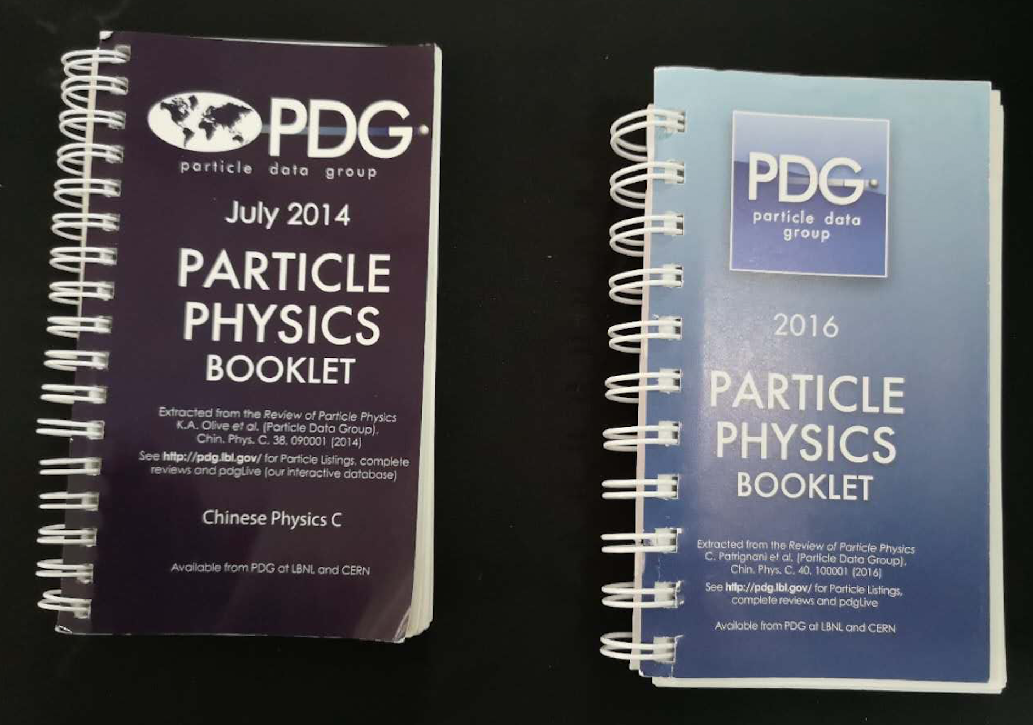
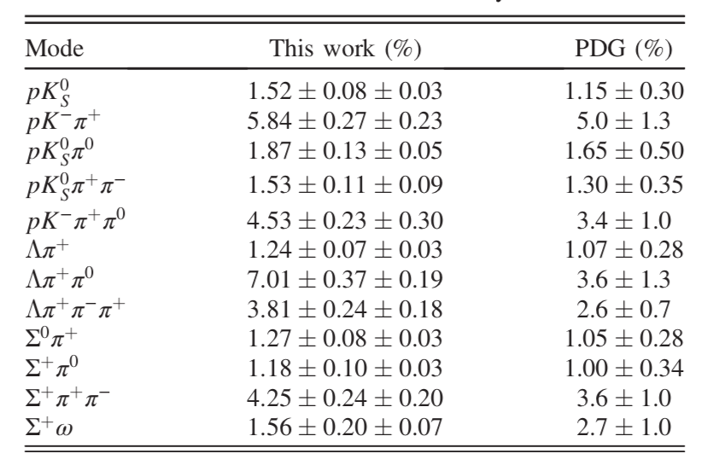
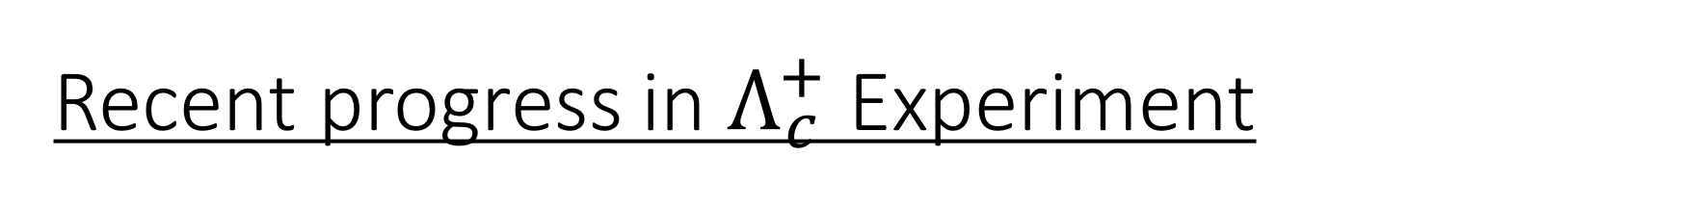
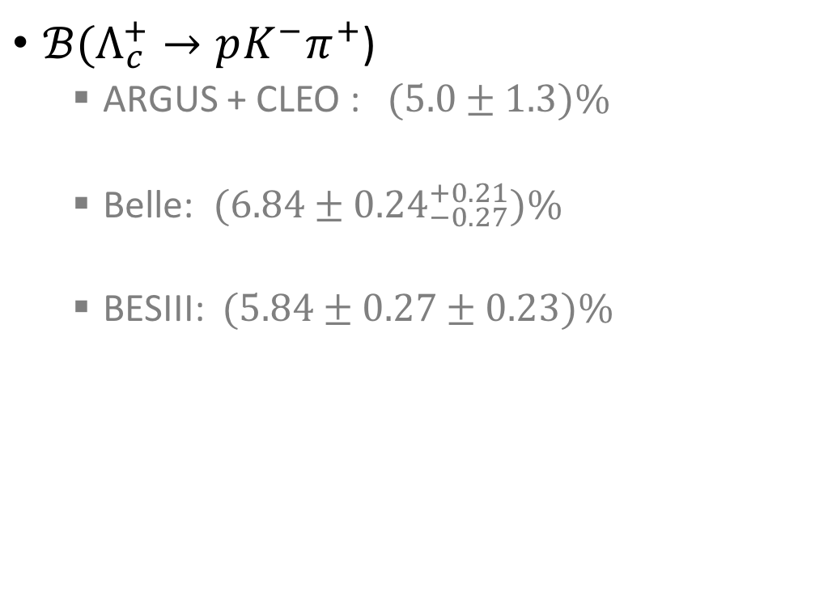

Recent progress in $Λ_{c}^{+}$ Experiment
$ℬ(Λ_{c}^{+}→pK^{−}π^{+}$)
ARGUS + CLEO :$(5.0±1.3)\%$
Belle: $(6.84±{0.24}_{−0.27}^{+0.21})\%$
BESIII: $(5.84±0.27±0.23)\%$
12 modes measured by BESIII
PDG 2014
Belle, PRL 113 （2014), 042002
BESIII, PRL 116（2016）, 052001
PDG 2016: $(6.35±0.33)\%$
PDG values for $Λ_{c}^{+}$ decay BFs before 2016 version become obsolete
Notes:
model dependence
model independence

Slide 6
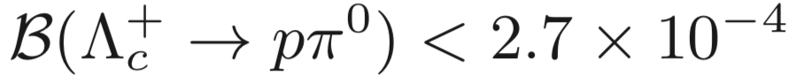
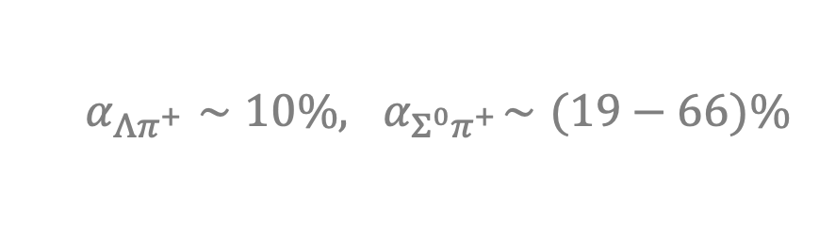
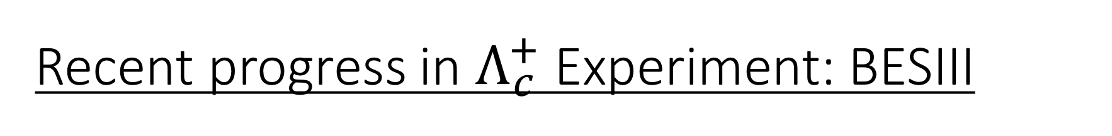
Recent progress in $Λ_{c}^{+}$ Experiment: BESIII
Singly-Cabibbo-suppressed decay has been measured
Neutral mode can be measured
The sensitivity of decay asymmetry will be improved
More precise measurement of Cabibbo-favored process
BESIII, PRD 95（2017), 111102
BESIII, PRL 118（2016), 112001
$$α_{Λπ^{+}}∼10\%,{ α}_{Σ^{0}π^{+}}∼(19−66)\%$$
D. Wang, R.-G. Ping, L. Li, X.-R. Lyu, Y.-H. Zheng , Chin. Phys. C 41 (2017) 023106
BESIII, PLB 783（2018), 200-206
BESIII, 1811.08028

Slide 7
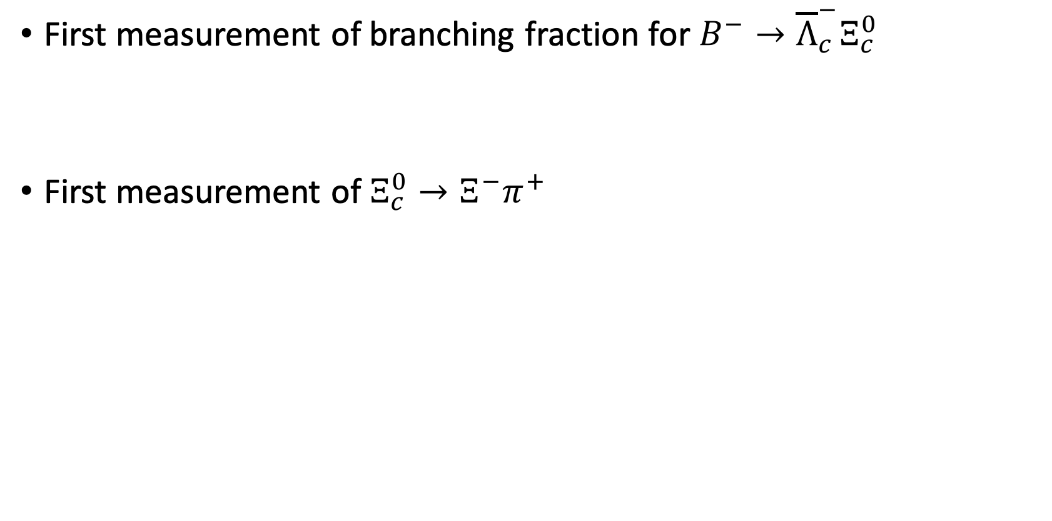
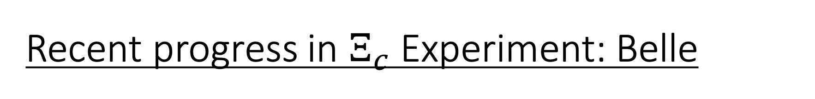
Recent progress in $Ξ_{c}$ Experiment: Belle
First measurement of branching fraction for $B^{−}→{\overline{Λ}}_{c}^{−}Ξ_{c}^{0}$
First measurement of $Ξ_{c}^{0}→Ξ^{−}π^{+}$
Belle, 1811.09738

Slide 8
Methodology for theoretical study
Hadron level: SU(3) approach
Irreducible representaion amplitude (IRA) (Geng, Hsiao et. al. and Lu, Wang, Yu et. al.)
Topological diagram amplitude (TDA) (He, Wang et. al.)
Quark level: dynamics is involved
Pole model : (Cheng, Xu)
…

Slide 9
Hadronic weak decay theory
Diagrammatic scheme (Chau, Cheng, Tseng; Kohara)
Factorizable contribution
Two distinct internal W emission diagrams, three different W exchange diagrams
Need information of decay asymmetry to extract s-wave and p-wave amplitudes separately
Non-Factorizable contribution

Slide 10
Fac. vs. NF. contribution
Some processes only have fac. contribution
Some only have nf. contribution
Some have both fac. & nf. contribution

Slide 11
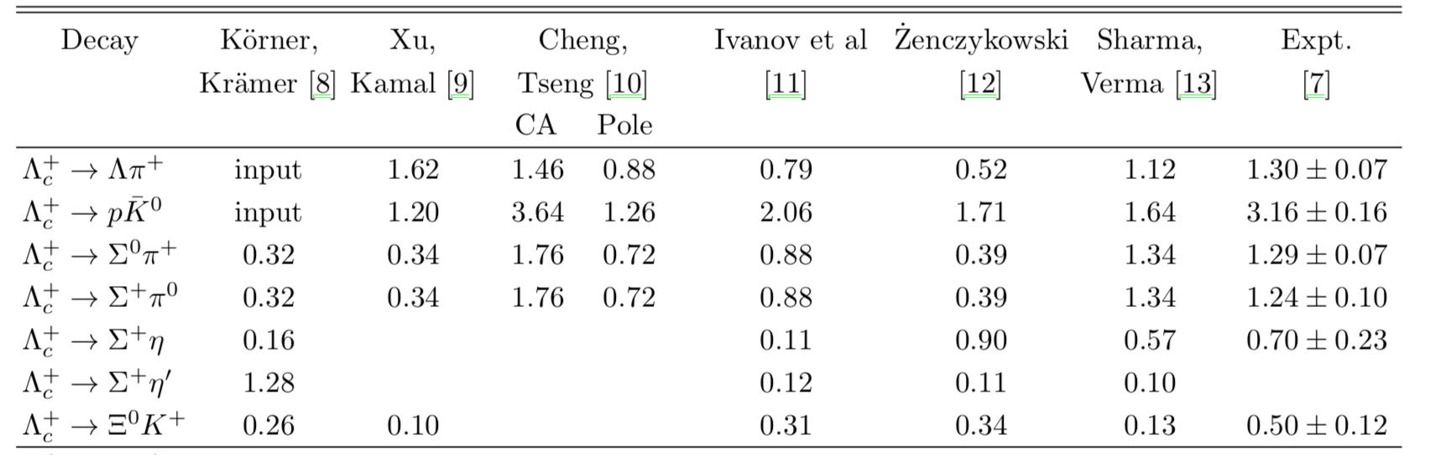
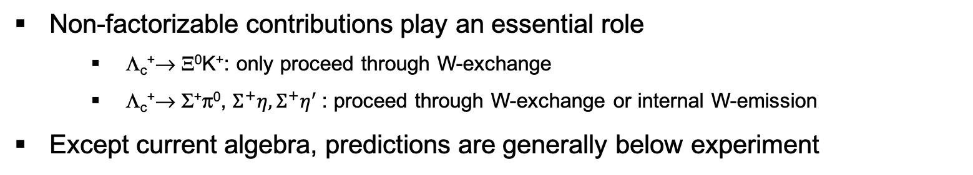
BF of Cabbibo-favored decays in 1990s
RQM Pole Pole RQM Pole C.A.
Non-factorizable contributions play an essential role
Λ_{c}⁺→ Ξ⁰K⁺: only proceed through W-exchange
Λ_{c}⁺→ Σ⁺π⁰, $Σ^{+}η, Σ^{+}η^{′}$: proceed through W-exchange or internal W-emission
Except current algebra, predictions are generally below experiment

Slide 12
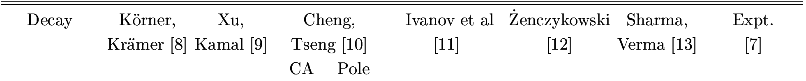

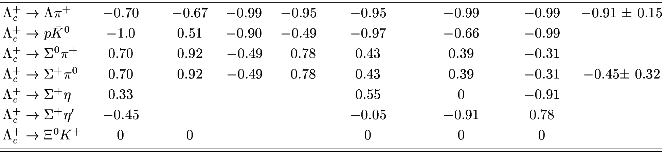
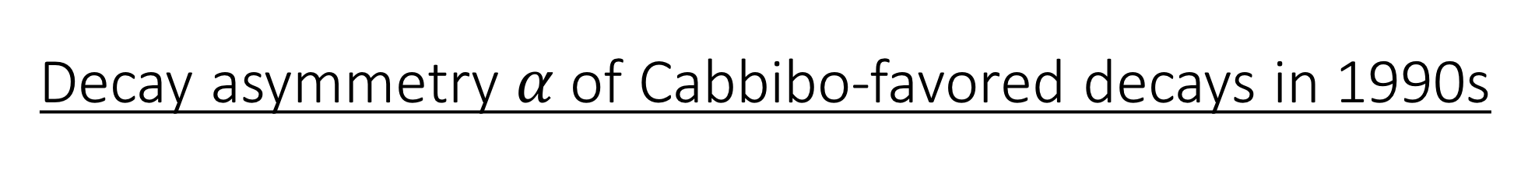
Decay asymmetry $α$ of Cabbibo-favored decays in 1990s
RQM Pole Pole RQM Pole C.A.
Λ_{c}⁺→ Σ⁺π⁰:
CLEO (’95) measured α = -0.45±0.31±0.06
Pole model & RQM predict positive α
Current algebra leads to negative α
-0.49 by H.-Y. Cheng et al.,
-0.76 by Zenczykowski (hep-ph/9309265),
-0.47 by Datta (hep-ph/9504428),
-0.31 by Sharma et al.
Λ_{c}⁺→ Ξ⁰ K⁺
theory: small s-wave ⇒ α = 0
experiment ?
BESIII, PLB 783（2018), 200-206

Slide 13
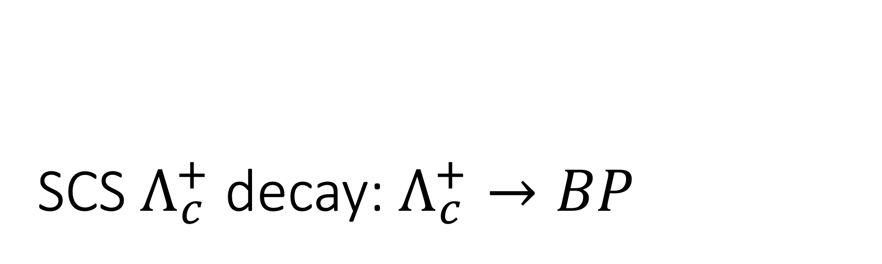
SCS $Λ_{c}^{+}$ decay: $Λ_{c}^{+}→BP$
A dynamical model calculation

Slide 14
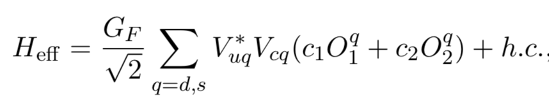
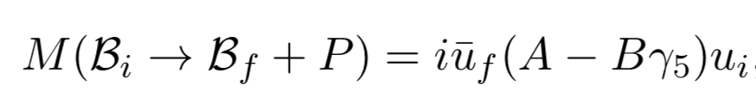
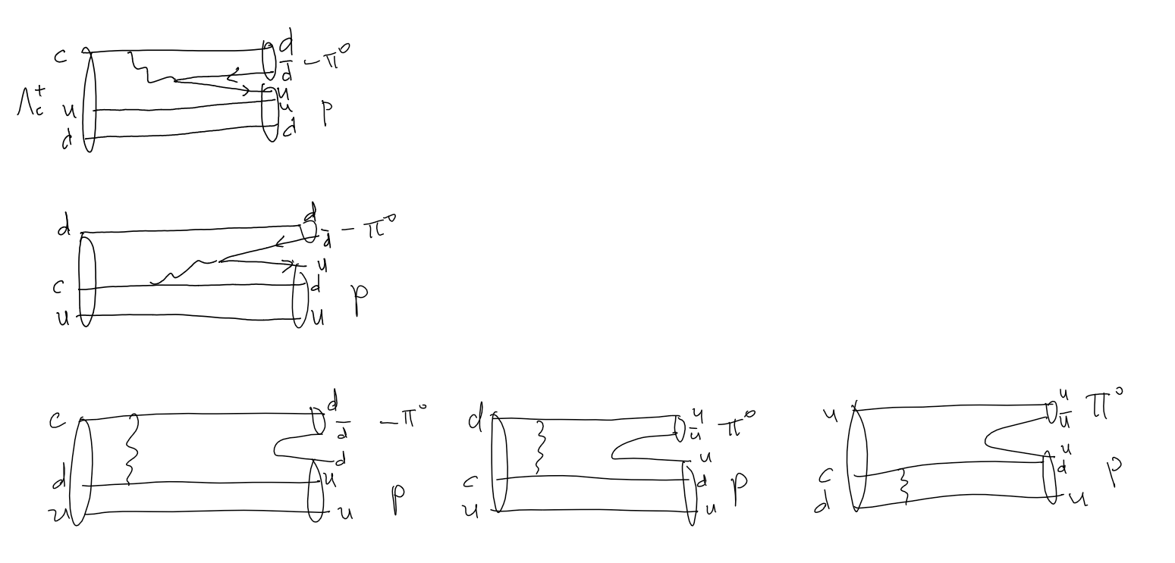
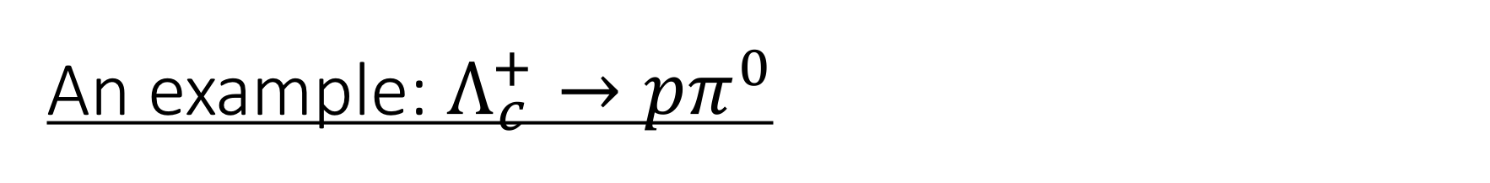
An example: $Λ_{c}^{+}→pπ^{0}$
internal W emission 1
internal W emission 2
W-exchange

Slide 15
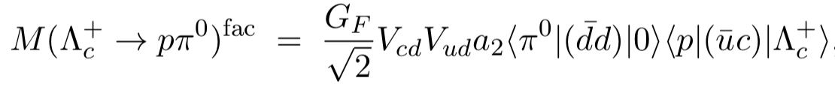
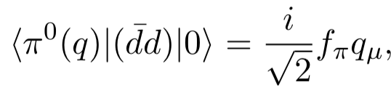
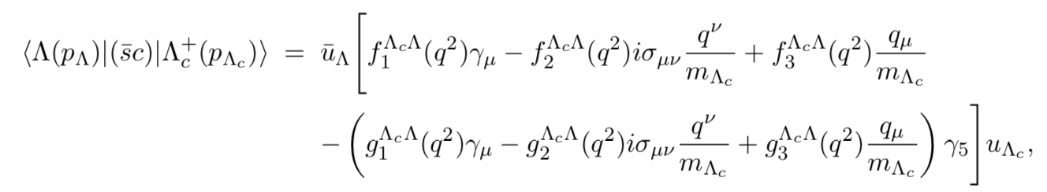
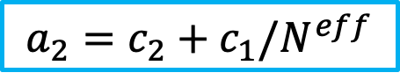
Factorizable contribution
$$a_{2}=c_{2}+c_{1}/N^{eff}$$
The form factors rely on model calculation
The Wilson coefficients rely on effective N

Slide 16
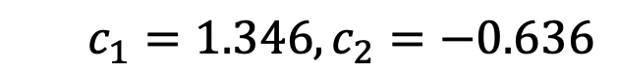
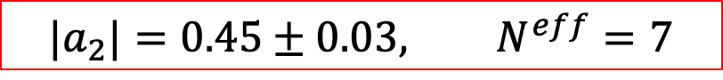
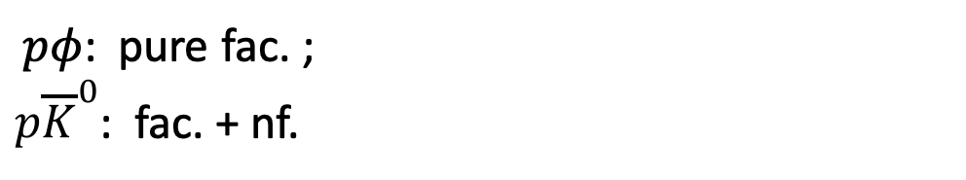
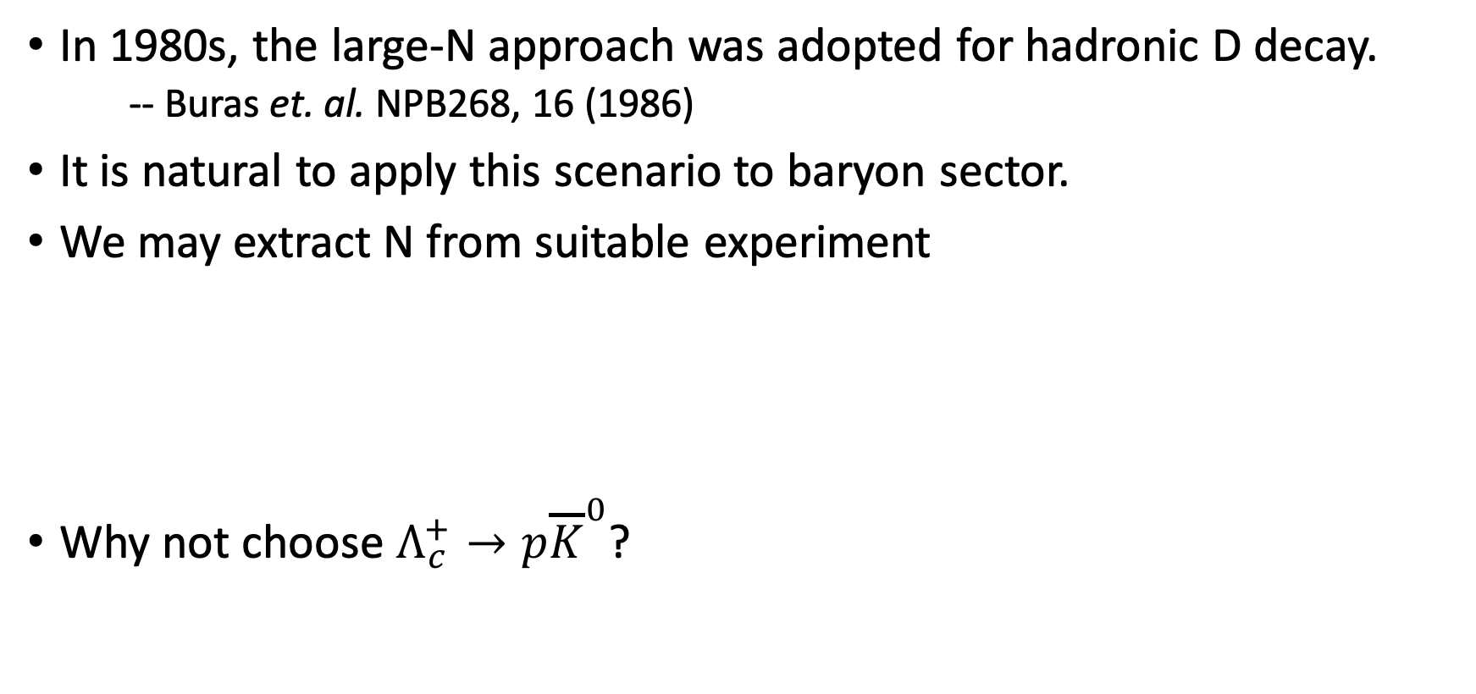
The issue about effective N
In 1980s, the large-N approach was adopted for hadronic D decay.
-- Buras et. al. NPB268, 16 (1986)
It is natural to apply this scenario to baryon sector.
We may extract N from suitable experiment
Why not choose $Λ_{c}^{+}→p{\overline{K}}^{0}$?
BESIII, Phys. Rev. Lett. 117, 232002 (2016).
$$c_{1}=1.346, c_{2}=−0.636$$
$${|a}_{2}|=0.45±0.03, N^{eff}=7$$
$pφ$: pure fac. ;
${p\overline{K}}^{0}$: fac. + nf.

Slide 17

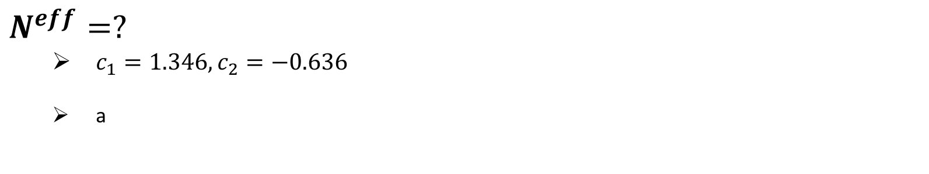

Factorizable contribution
$$a_{2}=c_{2}+c_{1}/N^{eff}$$
$$N^{eff}=?$$
$c_{1}=1.346, c_{2}=−0.636$
a
$${|a}_{2}|=0.45±0.03, N^{eff}=7$$
internal W-emission governed
BESIII, Phys. Rev. Lett. 117, 232002 (2016).

Slide 18
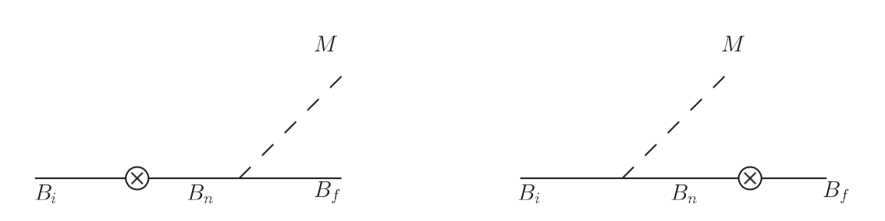
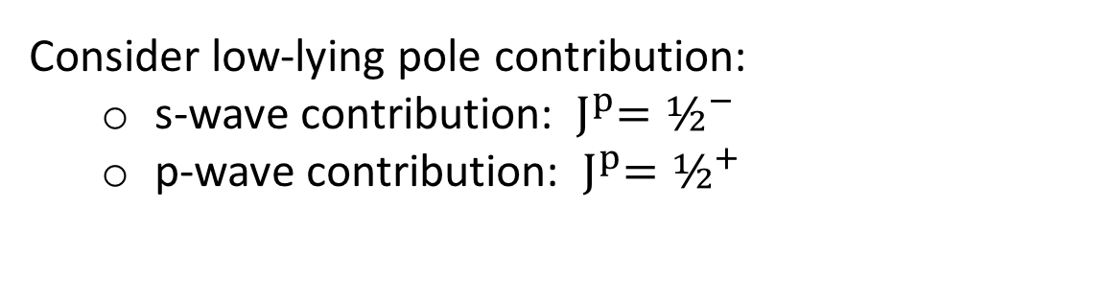
Non-factorizable contribution: Pole model
s-wave
p-wave
Dynamic model calculation
Pole model
Relativistic QM: Korner, Kramer, Ivanov…
Consider low-lying pole contribution:
s-wave contribution: ${ J}^{p}=½^{−}$
p-wave contribution: ${{ J}^{p}=½}^{+}$

Slide 19
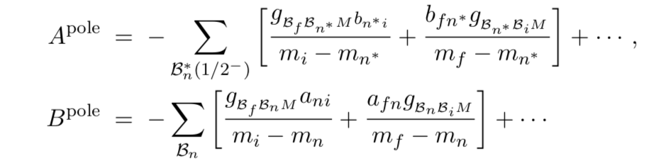
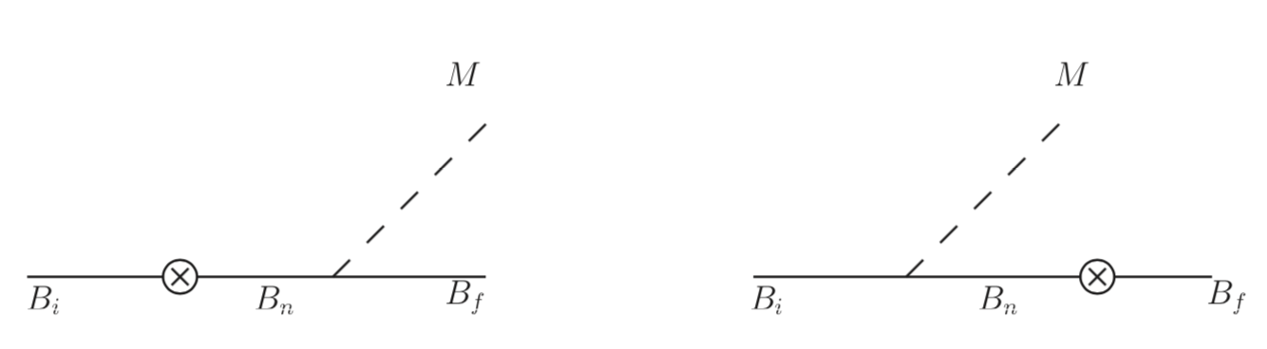
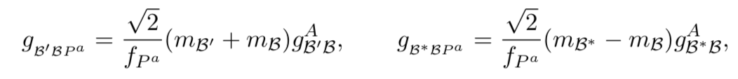
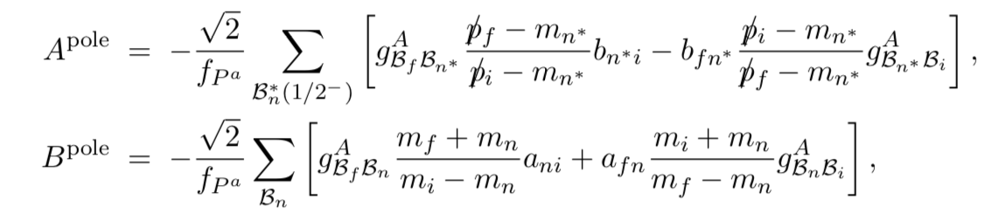
Non-factorizable contribution: Pole model
GT relation

Slide 20
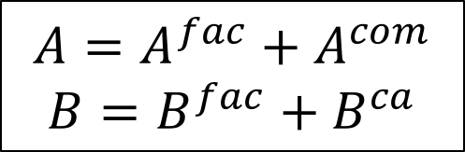
Current Algebra Approach
soft pseudoscalar-meson limit
s-wave, p-wave amplitudes
$$A={A^{fac}+A}^{com}$$
$$B=B^{fac}+B^{ca}$$

Slide 21
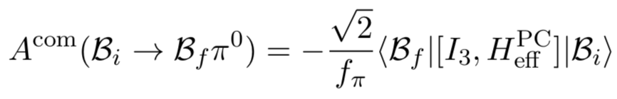
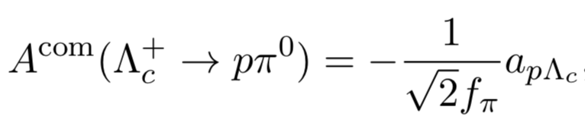
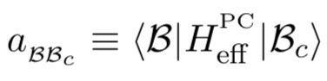
s-wave, p-wave contribution
Calculation of commutator

Slide 22
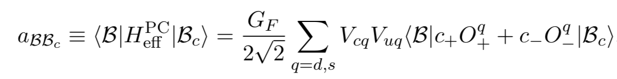







Baryon Matrix element: MIT bag model calculation
$$\overline{15}$$
6

Slide 23


Strong coupling: MIT bag model calculation
axial-vector form factor
GT relation

Slide 24
Results and Discussion

Slide 25





Numerical results:$Λ_{c}^{+}$
The measured mode $pη$ , BF is in great agreement with experiment.
Several unmeasured mode, including $pπ^{0}$ and ${nπ}^{+}$, are predicted for both BF and $α$.
All decay asymmetries are predicted negative.
Hai-Yang Cheng, Xian-Wei Kang, FRX, PRD 97, 074028 (2018);

Slide 26


$$Λ_{c}^{+}→pπ^{0}, pη$$
The reason for $B\left(pη\right)>B(pπ^{0})$
Nonfactorizable terms contribute
constructively to $pη$
destructively to $pπ^{0}$

Slide 27




Numerical results:$Ξ_{c}^{+,0}$
preliminary
The measured mode $Ξ^{−}π^{+}$ agrees well with Belle measurement.

Slide 28




Numerical results:${ Ξ}_{cc}^{++}$
preliminary
Korner et. al. , 1812.09212

Slide 29

Comparison of BF with different groups
preliminary
no s-wave Fac.

Slide 30

Summary
$Λ_{c}^{+}$ SCS decays have been calculated in a dynamic model.
$pη$ finds in great agreement with experiment.
$pπ^{0} , nπ^{+}$ and some other modes have been predicted;
$pπ^{0}$ satisfies current BESIII experiment limit.
All decay asymmetries for $Λ_{c}^{+}$ are calculated to be negative, testable by BESIII.
Preliminary doubly charmed baryon and $Ξ_{c}^{0}$decay results are obtained.

